Slide 1
Automatic image recognition in upload filters - computing of transparent decisions (XAI), with the help of Deep Learning methods
Timo Bohnstedt
Assessor : Prof. Dr. Alfred Holl
Supervisor: Prof. Dr. Gallwitz Faculty of Computer Science Technische Hochschule Nürnberg Georg Simon OHM July 19th, 2020
Notes:
Read the Title
The impressive applications triggered my motivation

Slide 2
Introduction
Copyright law reform: Germany considers upload filters
Notes:
For example so called Image-to-Image Translation
Founded by Jun-Yan Zhu in their 2017 paper titled “Unpaired Image-to-Image Translation using Cycle-Consistent Adversarial Networks”
Translation from artistic painting style to photographs
Translation from Summer to Winter
Translation from photographs to artistic painting style from different artists

Slide 3
Introduction
Sharehosters would need to start monitoring all user behaviour consequences which could harm the business of small content creators
Notes:
For example so called Text to Image Synthesis
Founded by Han Zhang, et al. in their 2016 paper titled “StackGAN: Text to Photo-realistic Image Synthesis with Stacked Generative Adversarial Networks”
use of GANs, specifically their StackGAN to generate realistic looking photographs from textual descriptions of simple objects like birds and flowers.

Slide 4
Introduction
Explainable artificial intelligence could help to make upload filter technology like deep learning more transparent
Notes:
Founded by Christian Ledig, et al. in their 2016 paper titled “Photo-Realistic Single Image Super-Resolution Using a Generative Adversarial Network”
demonstrate the use of GANs, specifically their SRGAN model, to generate output images with higher, sometimes much higher, pixel resolution.

Slide 5
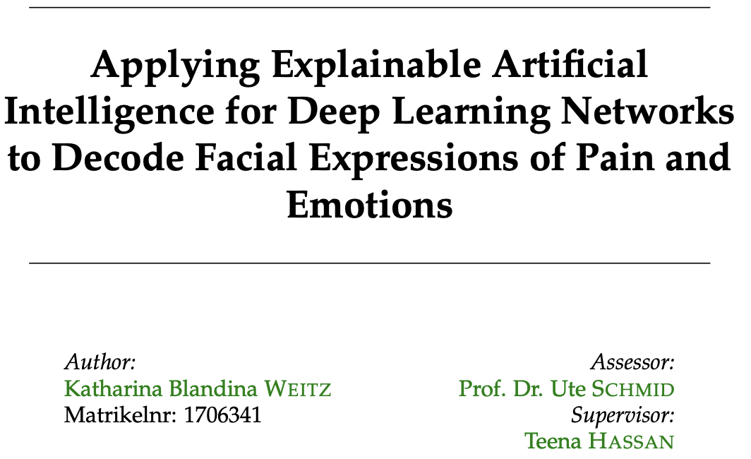
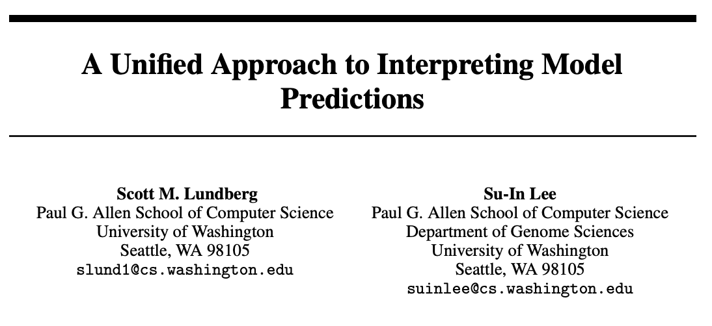
Related Work
XAI within the medical filed
Make predictions transparent
Notes:
Two papers have adressed these problems
1. The Improved Techniques Paper was a fellow up work by the Founder of GANs itself.
They introduced a vareitey of methods in order to reduce the training time and prevent mode collapse
2. Phillips Isola and his colleques introduced labels as conditions in order to ensure the generated images have a sprecific inter class variance
It works prefictly fine to prevent models for mode collapse

Slide 6
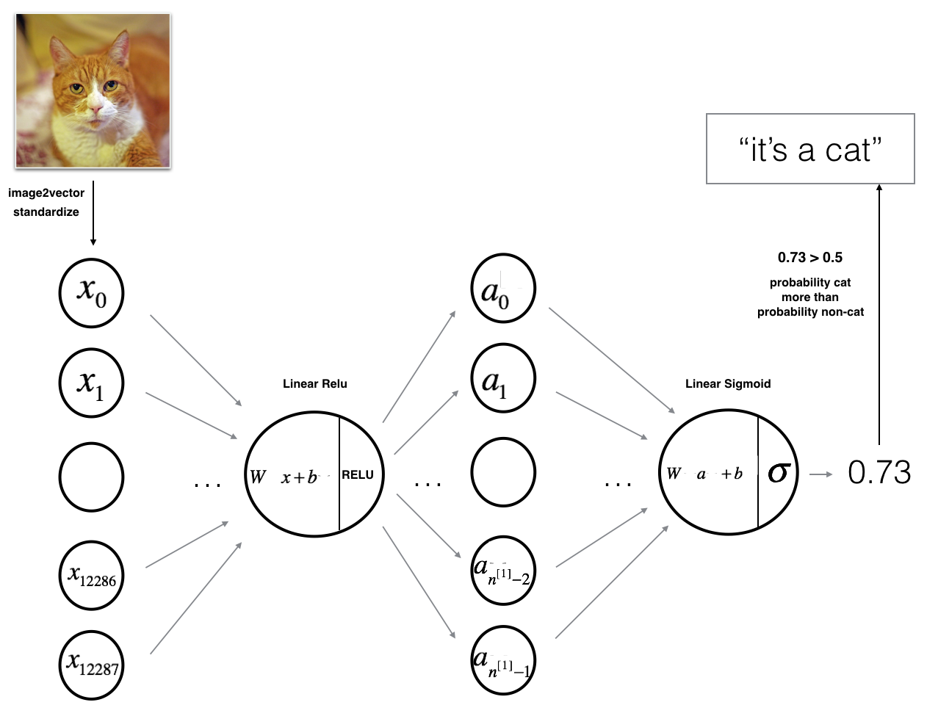
Background and Theory
A deep learning application for image classification
Notes:
My objetie was to use GANs for a simple use case scenario
Faced to major problems
slow training
mode collapse

Slide 7
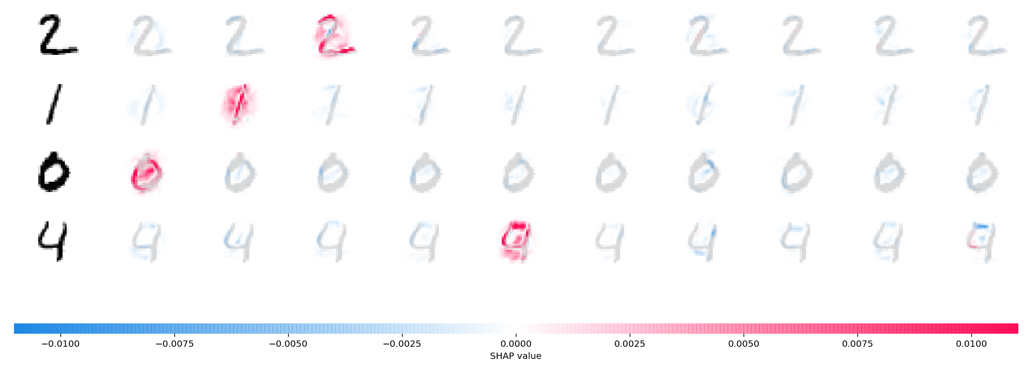
Background and Theory
Implementation of Shapley values and integrated gradients as a method which could make deep learning more transparent by investigation the future importance
Notes:
My objetie was to use GANs for a simple use case scenario
Faced to major problems
slow training
mode collapse

Slide 8
Requirements
🔴 Ability to predict
🔴 Ability to calculate SHAP values
🔴 Ability to visualize SHAP values
Notes:
- Second szenerio: we are not loner in the past such we want to improve our processes in industry 4.0 in order to build a bridge
- Backstep to motivation

Slide 9
Requirements
A prototype to apply methods of
transparent decision making
Notes:
With the countless opportiones, and the difficulits in mind I asked myself if I can ....
Can we generate real looking images?
Can we introduce enough inter-class variance for training?
while using the foundamentals of the realted work I have found

Slide 10
Functional Specifications
How data gets processed within the prototype
Notes:
With the countless opportiones, and the difficulits in mind I asked myself if I can ....
Can we generate real looking images?
Can we introduce enough inter-class variance for training?
while using the foundamentals of the realted work I have found

Slide 11
IT Specifications
Which technologies are used within the prototype implementation
Notes:
The MNIST database (Modified National Institute of Standards and Technology database) is a large database of handwritten digits that is commonly used for training various image processing systems.^{[1][2]} The database is also widely used for training and testing in the field of machine learning.^{[3][4]}
I used it because it was simple enough to start with while it has the sample general difficulites when it comes to gan training as other data sets.
But without the difficulites for more challengin datasets as a high resuliton

Slide 12
Generalization
Difficult because of the assumptions
Deep Learning and XAI are difficult to
implement in real-world upload filter applications
More research has to be done in order to make XAI applicable in upload filters
Notes:
Explain how I got from one Problem to another
Had a large Dataset (Large because of the high resuliton)
Models was unstable
Difficult to Tune

Slide 13
Conclusion
🟢 Ability to predict
🟢 Ability to calculate SHAP values
🟢 Ability to visualize SHAP values
Notes:
- Second szenerio: we are not loner in the past such we want to improve our processes in industry 4.0 in order to build a bridge
- Backstep to motivation

Slide 14
Thanks for your attention!

Slide 15
Sources
Figure 1: Photo by Tim Lüdeman, 2019, retrieved from https://advox.globalvoices.org/2019/03/07/we-are-not-bots-in-berlin-thousands-protest-proposed-eu-regulation-on-internet-upload-filters/
Figure 2: Photo by Julia Reda, 2019, retrieved from https://juliareda.eu/eu-copyright-reform/censorship-machines/
Figure 3: Photo by Nisarg Dave, 2019, retrieved from https://www.linkedin.com/pulse/explainable-ai-understanding-decisions-data-driven-deep-nisarg-dave/
Figure 4: Katharina Weitz in their 2019 paper titled "Applying Explainable Artificial Intelligence for Deep Learning Networks to Decode Facial Expressions of Pain and Emotions"
Figure 5: Scott Lundeberg, et al. in their 2017 paper titled "A Unified Approach to Interpreting Model Predictions"
Figure 6: Created by Timo Bohnstedt Jan 2020
Figure 7: Scott Lundeberg, et al. in their 2017 paper titled "A Unified Approach to Interpreting Model Predictions" retrieved form https://github.com/slundberg/shap
Figure 8: Created by Timo Bohnstedt June 2020
Figure 9: Created by Timo Bohnstedt June 2020
Figure 10: Created by Timo Bohnstedt June 2020
Notes:
Image-to-Image Translation with Conditional Adversarial Networks

